Slide 1
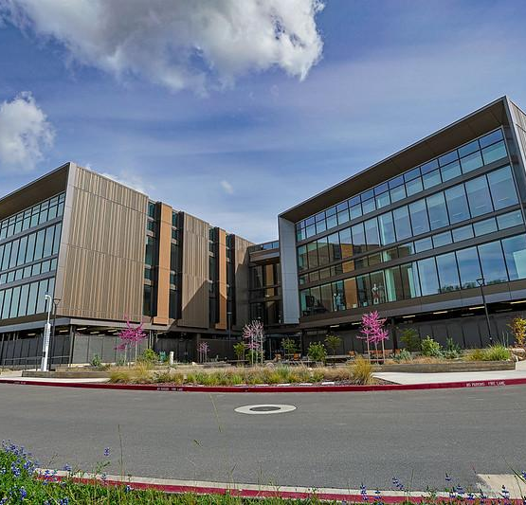
The California Community Colleges and the Cradle-to-Career (C2C) Data System
John Hetts Executive Vice Chancellor, Research, Data, and Analytics
David O’Brien Vice Chancellor of External Relations
Jory Hadsell Visiting Executive, Strategic Technology Initiatives

Slide 2
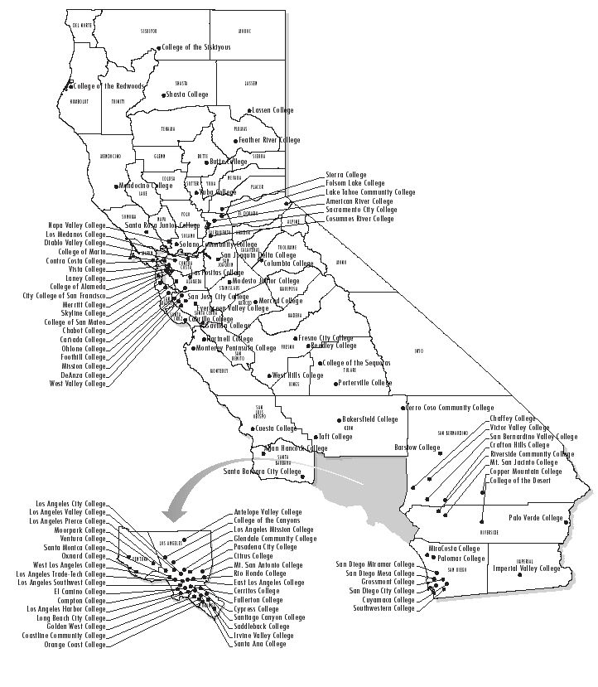
Largest System of Higher Education in the Nation
More than 2.2 million students
>10% of all undergraduates in the US
More than 200,000 awards per year in over 20,000 programs of study
73 Locally Governed Districts
116 colleges
448 locally elected trustees
136 CEOs (Chancellor’s and Presidents)

Slide 3

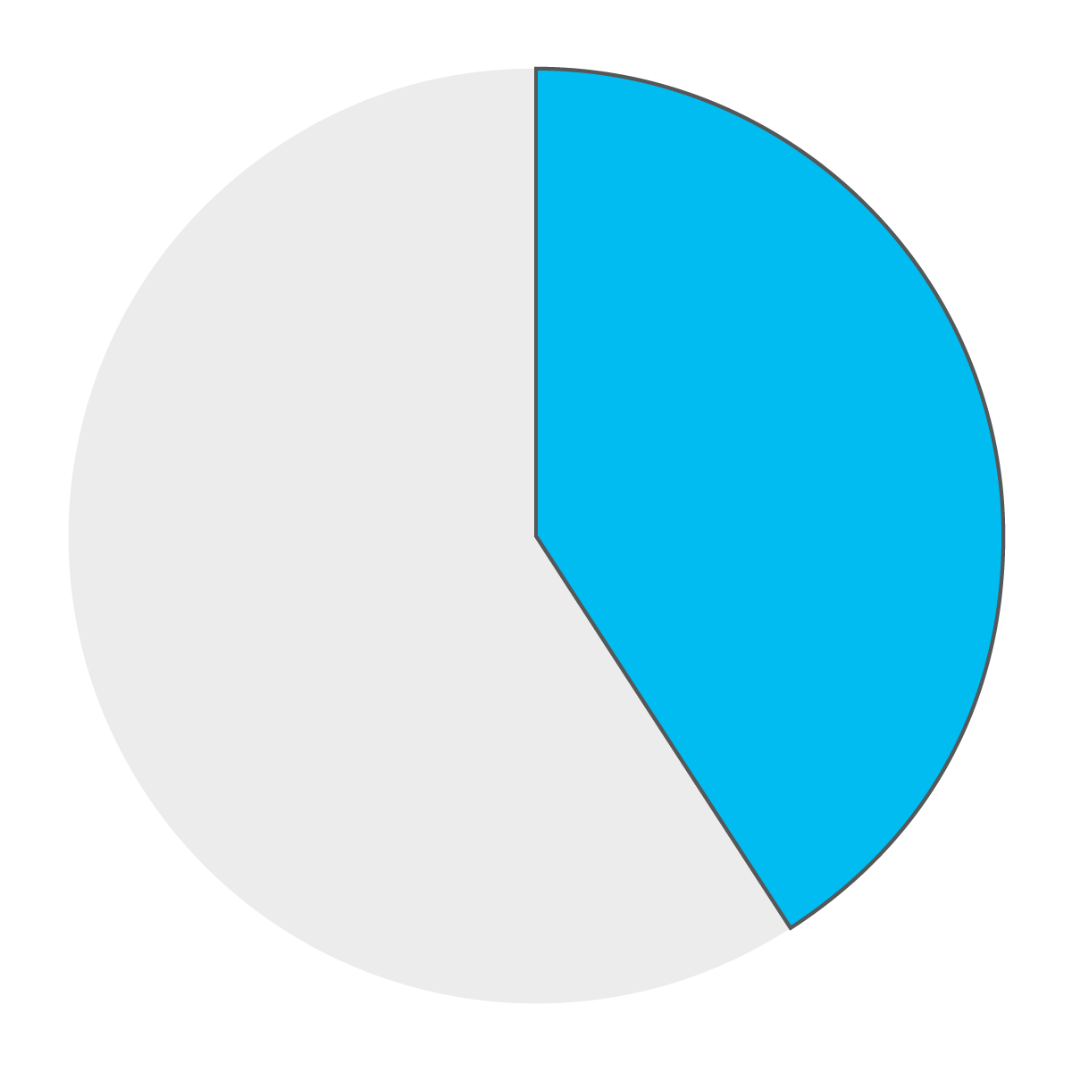
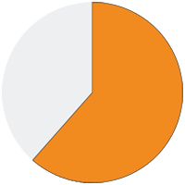
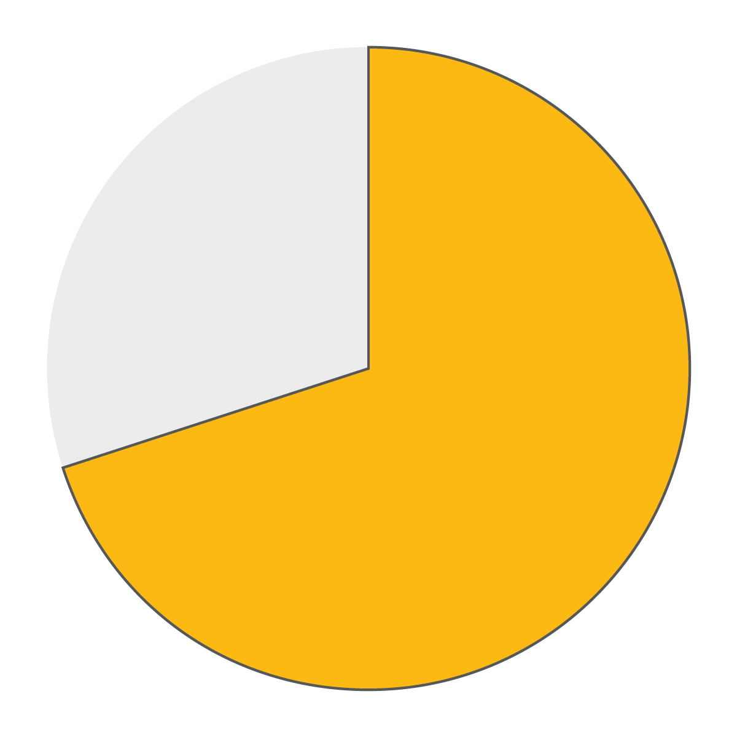
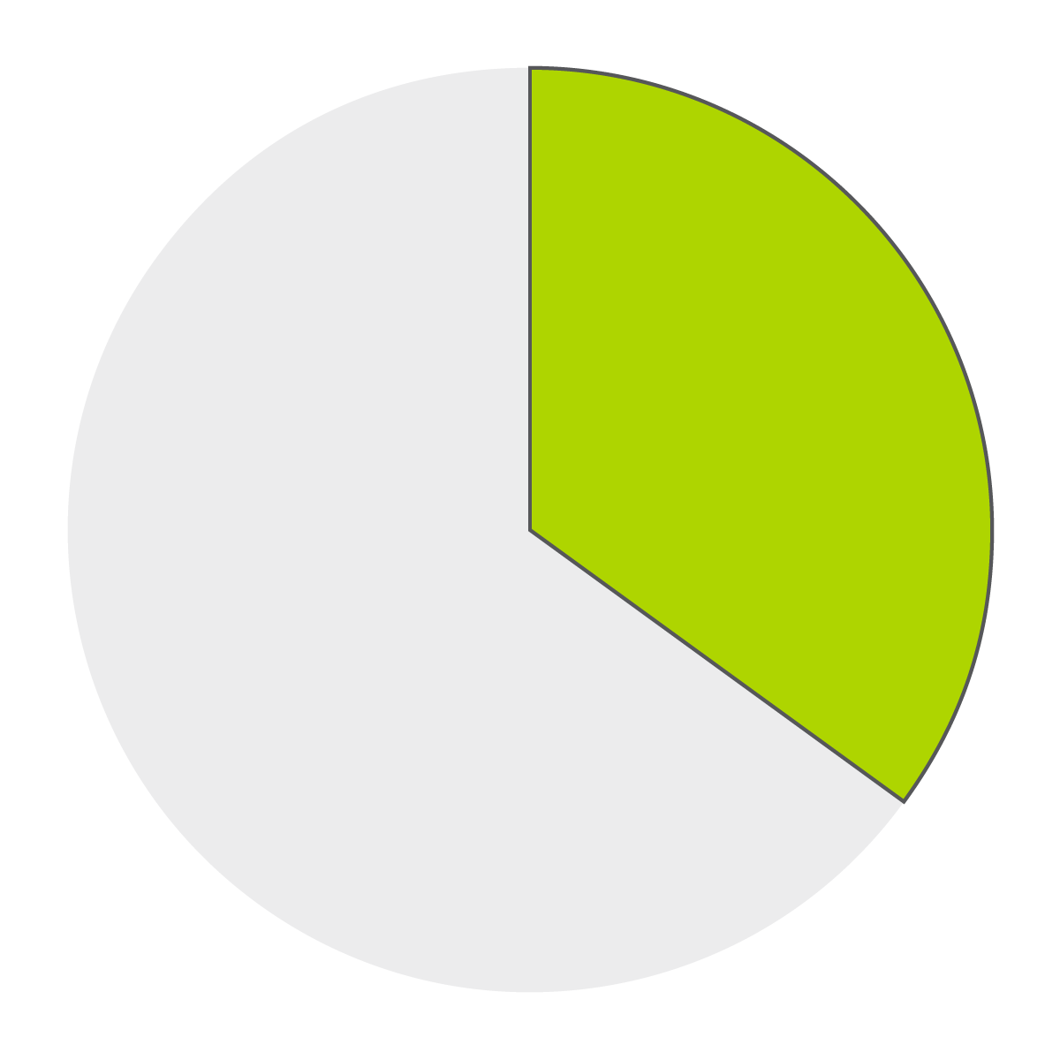
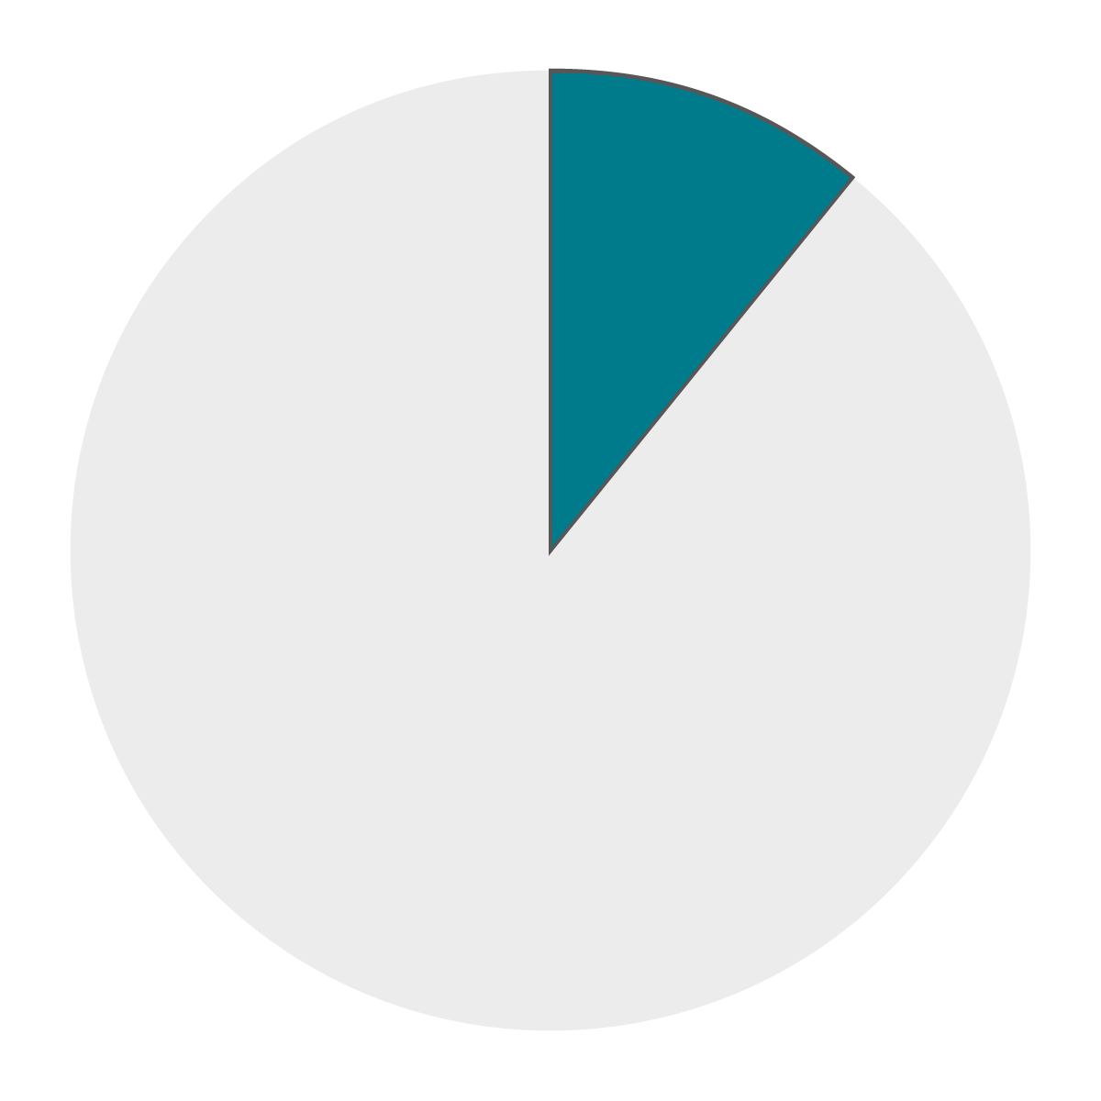
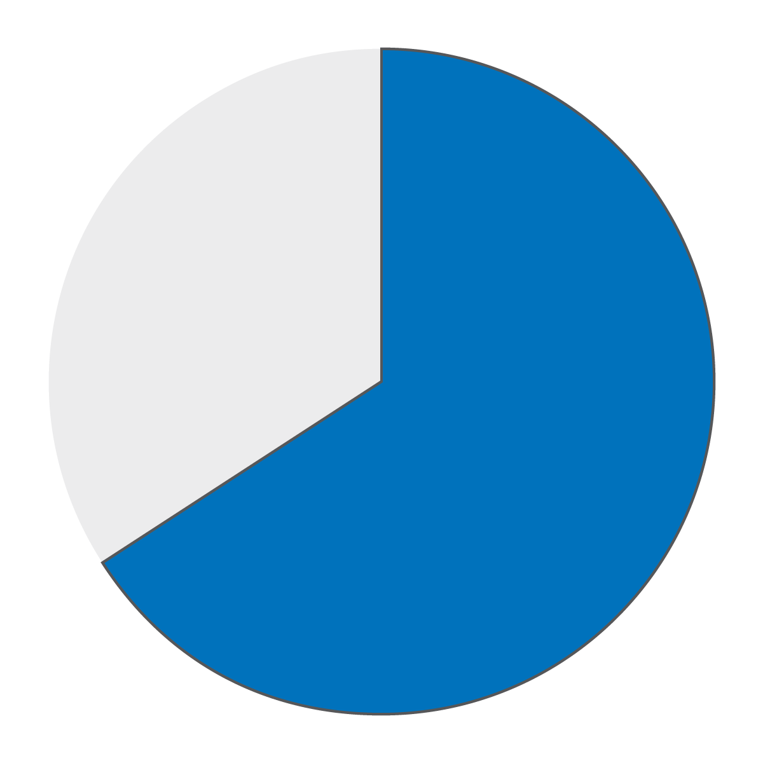
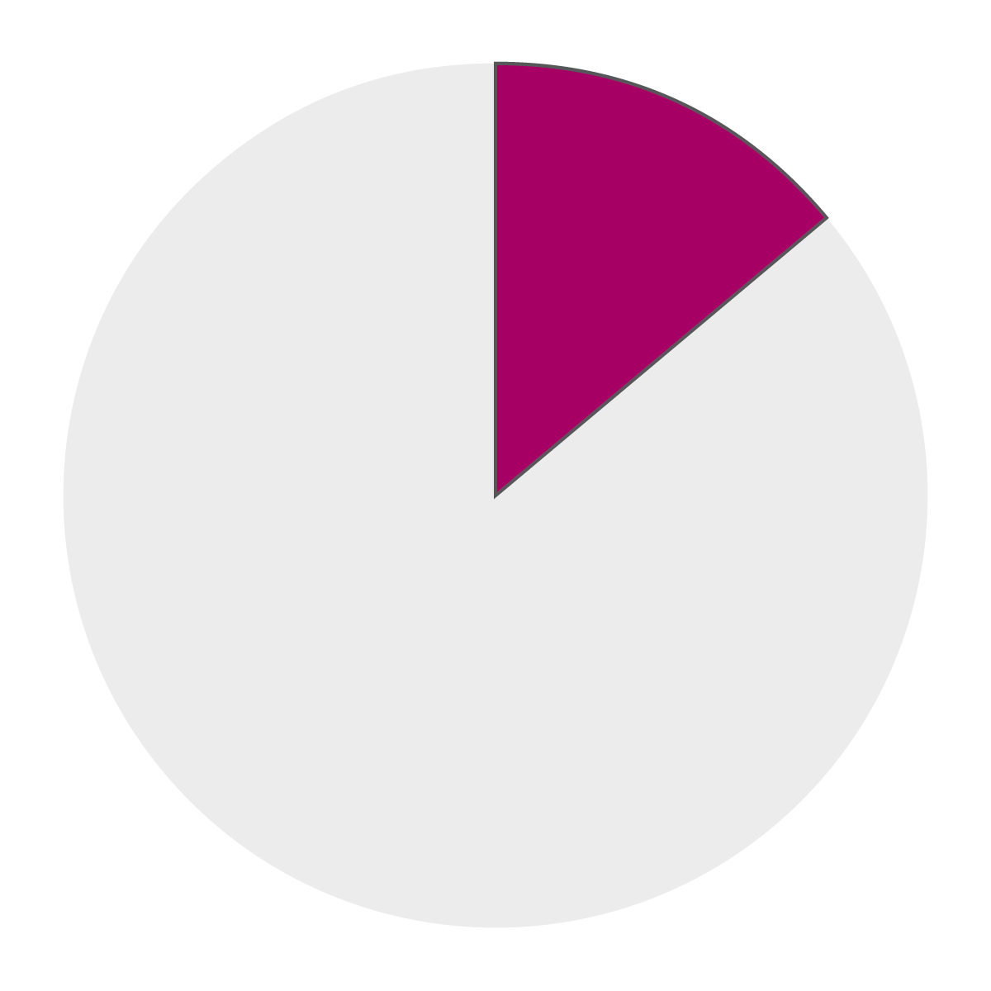
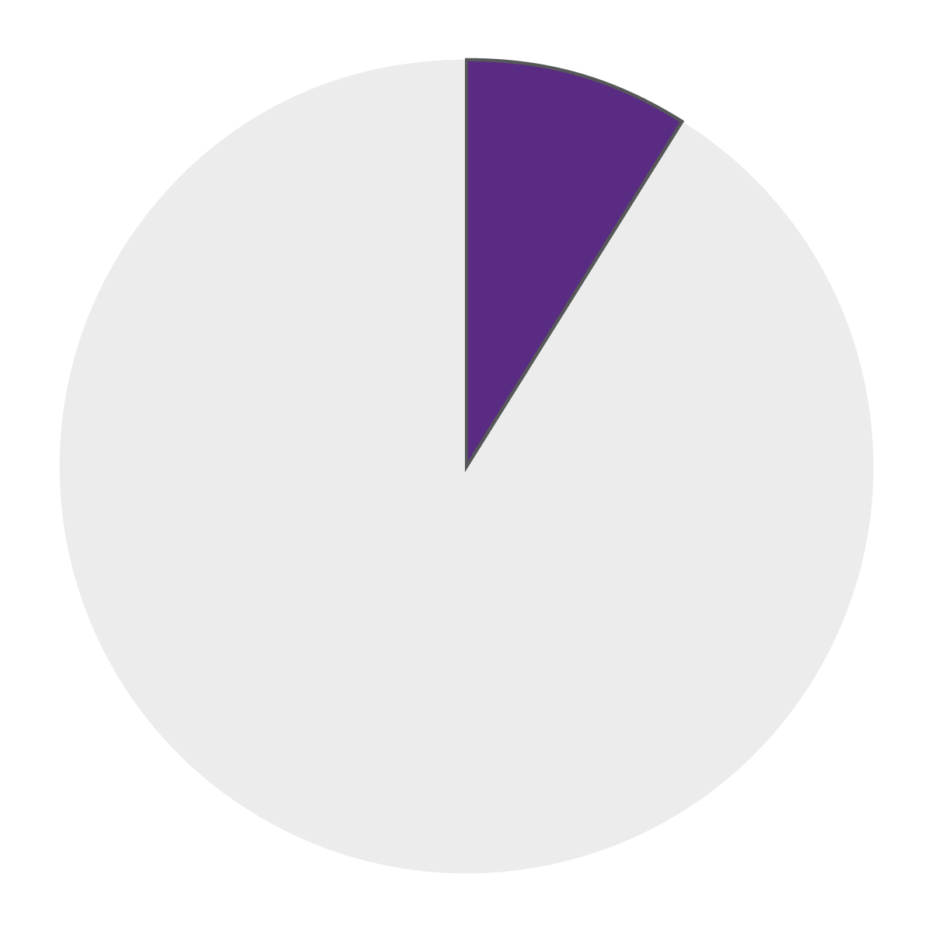

THE CALIFORNIA COMMUNITY COLLEGE STUDENTS OF TODAY
74% Part Time or Noncredit
41% Adult Students
64 % Working Learners
18% with an Associate Degree or Higher
72% Students of Color
46% First Generation
63% Economically Disadvantaged
15% Dual Enrollment
15% Noncitizens
Notes:
Of known respondents.

Slide 4
Engines of Social and Economic Mobility
Fully open access institutions to provide all Californians a wide range of educational opportunities including: associate and baccalaureate degrees, preparation for four-year institutions, workforce education, adult skills courses, retraining, and lifelong learning.
Most diverse student body of any system of higher education.
Largest provider of workforce training in the state and nation.
Nearly 30% of UC and 50% of CSU undergraduates started at a California Community College.

Slide 5
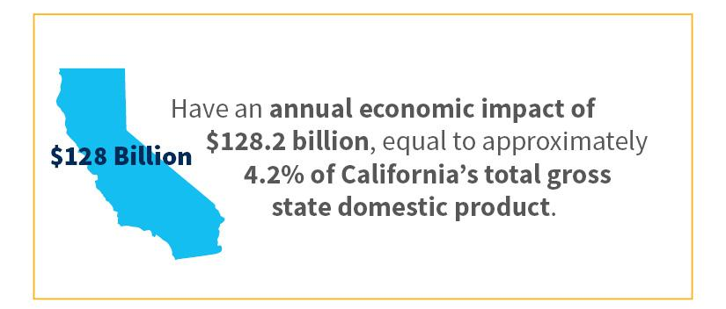
California Community Colleges Economic Impact
https://www.cccco.edu/-/media/CCCCO-Website/docs/report/ccc-1819-mainreport-final-a11y.pdf
Notes:
Analyzing 2018-19 data, the report found that Colleges have an annual economic impact of $128.2 billion, equal to approximately 4.2% of California’s total gross state product, or the sum value from all goods and services in the state.

Slide 6
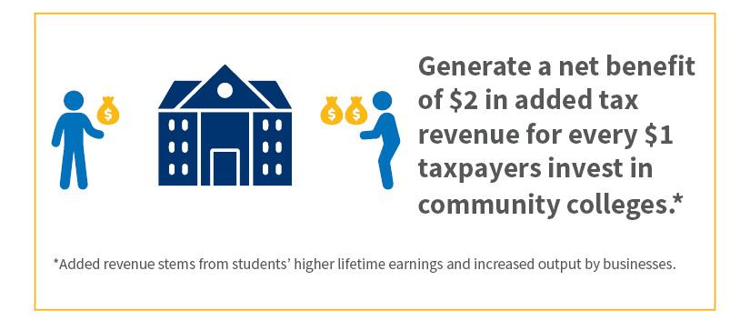
Strong Return on Investment for Taxpayers
Notes:
Among 292 California higher education’s institutions, 17 of the top 20 institutions in price to earnings ratio – i.e., the years it takes to recoup costs for low to moderate income students – 17 of the top 20 are California community Colleges. 30 of the top 40.
The California Community Colleges provide a bountiful return on investment for taxpayers. For every tax dollar spent on educating students attending the colleges, the public will receive an average of $2.10 in return over the course of the students’ working lives.

Slide 7
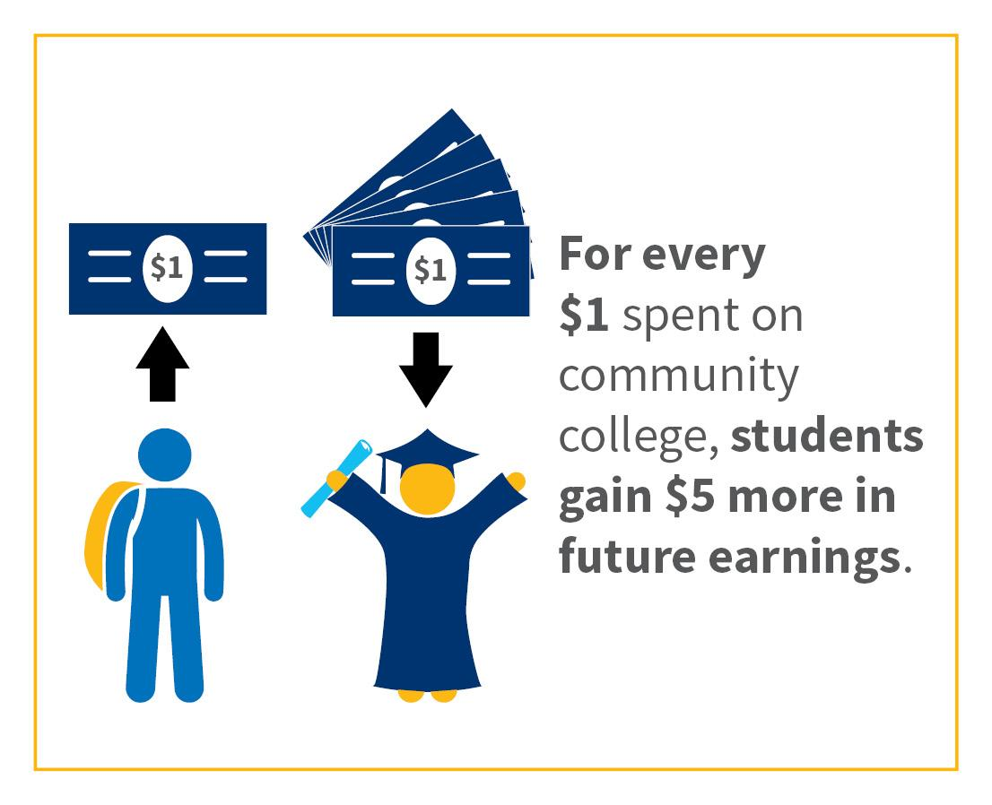
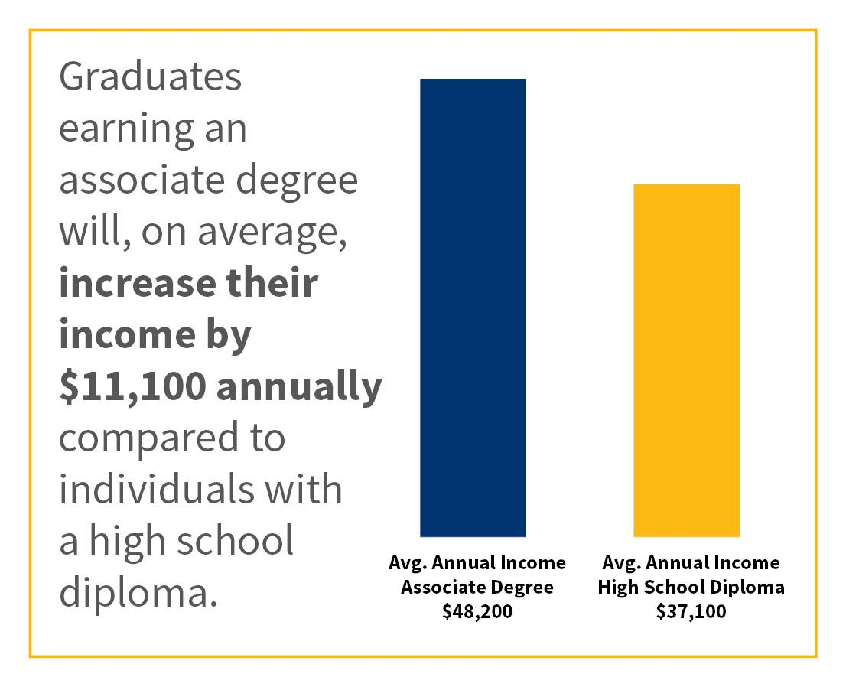
Enormous Return for Students
Notes:
For students the news gets even better. For every $1 invested, students will gain $5 in higher future earnings. The average community college graduate with an associate degree will see an increase in earnings of $11,100 annually, when compared to a person with a high school diploma or equivalent

Slide 8
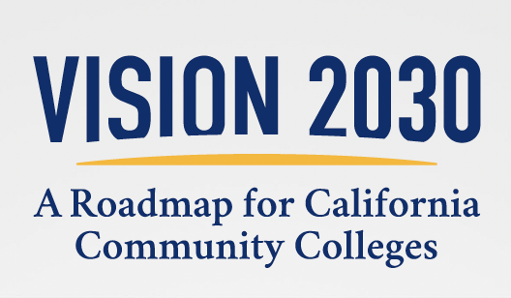
July 2025 Edition
Reimagining access, support, and success
Bring college to the student
Reduce barriers through innovation
Use data to power student success
Increase economic opportunity with equity
Strategically integrate technology

Slide 9
2026-27 Budget and Legislative Request
Equitable Baccalaureate Attainment - Strengthening Cross-Sector Partnerships and Coordination
Credit for Prior Learning - $35m One-Time and $2m ongoing
Equitable Baccalaureate Attainment - Providing Targeted Supports for Focused Learner Populations
Dual Enrollment Expansion - $24.2m one-time
The Future of Learning and Generative Artificial Intelligence
Common Cloud Data Platform - $36m one-time and $9m ongoing

Slide 10

California’s Career Passport

Slide 11
What the Career Passport will be
The California Career Passport facilitates hiring based on the skills that people already have. It provides a personalized digital wallet that people can use to share verified academic and nonacademic skills electronically with employers. It consists of the following:
Statewide credential registry
Delivery of academic credentials, including CPL, from an updated eTranscript CA
Delivery of non-academic credentials
Digital wallet, fully owned and managed by the learner
Verified digital resume

Slide 12
Technology Procurement & Partnerships
Procurement process:
Requirements gathering
Drafting of RFP
Advertising and evaluating single or multi-vendor proposals
Awarding and contracting
Begin implementation
...this phase starting early to meet 2027 launch goal
Two RFPs for related, but separate platforms that must integrate

Slide 13
Career Passport and eTranscript CA
Two aligned initiatives that will work together to create a trusted, interoperable ecosystem for academic and verifiable skills-based records
Systems and Components
eTranscript California
Re-launch eTranscript RFP for upgraded platform now that funding is in place
Deliver transcripts between institutions with improved capabilities
Integrate with CPL
Elevate data exchange via standards (outputs beyond transcripts)
Career Passport
Digital Wallet
Skills Registry
Academic credentials and CPL integration <-- eTranscript CA
Non-academic credentials
Digital Resume

Slide 14
Procurement Strategy: Driving Integration
Both RFPs will frame the projects as interdependent and require standards-based integration capabilities.
01
02
Emphasis on Integration & Interoperability
Leveraging Past eTranscript Inputs
Refined procurement approach for both eTranscript California and the Career Passport focuses on creation of a cohesive and learner-centric ecosystem. New RFPs will heavily prioritize integration capabilities between systems, ensuring data flows efficiently.
The 2025 eTranscript California RFP, though not awarded, provides a critical "head start." The new RFP will build upon this foundation and the collaborative intersegmental requirements gathering.
03
04
Reframing eTranscript Requirements
Targeted Timeline
The revised eTranscript RFP will have increased focus on interoperability, highlight integration with the Career Passport, and emphasize credit data transfer in addition to transcripts, while promoting a learner-centric orientation.
The updated eTranscript California RFP will be released in early Spring 2026, with a contract award expected before Summer 2026. The Career Passport RFP will likely launch with or slightly after the eTranscript California RFP.

Slide 15
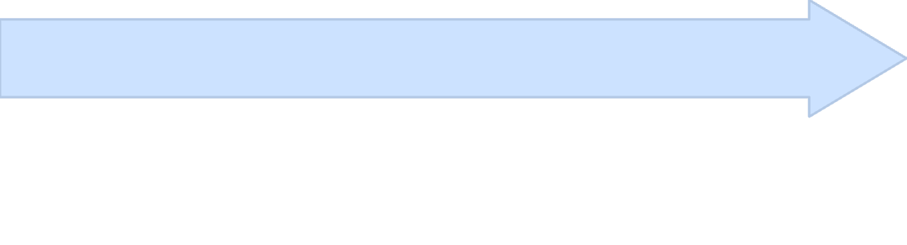

High Level Procurement Timeline
Our strategic timeline outlines the key phases for developing, launching, and integrating eTranscript California and the Career Passport, fostering a truly interoperable educational and career ecosystem.
Summer/Fall 2026:Planning, Pilot, and 2027 Launch
Late Spring 2026: Vendor Selection & Contracting
2025 – Early Spring 2026:RFP Development & Launch
Finalize implementation plans, including strategy for implementation.
Evaluate proposals & conduct technical reviews (likely April - May 2026.
Finalize functional & technical specifications.
Begin onboarding, integration design, & environment setup (Q3 2026).
Integrate open-API & data standards (PESC, CTDL, Open Badges v3, etc.).
Complete vendor selection & contract awards by June 2026
Deploy pilot cohort with initial colleges & selected CSU/UC receivers (early 2027).
Release two RFPs (eTranscript + Career Passport) January / February 2026.
Begin technical deployment planning, including planned integrations between eTranscript and Career Passport.
Collect user & partner feedback; refine integration & messaging.
Communicate rollout plan with CSU, UC, AICCU, and C2C partners.
Ensure vendor and technology alignment.
Prepare for Phase 1 operational status & public system launch (mid 2027)
"Unified modernization — two connected procurements, one learner-centered ecosystem."

Slide 16

What Success Looks Like
Seamless Exchange
Learner Ownership
Employer Access
Effortless digital transcript sharing across CCC, CSU, UC, and external institutions.
Students securely own and share their verified academic and skills records via the Career Passport.
Employers access trusted, verified skills data for smarter hiring decisions and workforce development.
California sets a national model for interoperable, equitable digital credentials through ongoing collaboration and transparency with all higher education and industry partners.

Slide 17
What comes next
To launch the Career Passport, we will pursue each of these lines of work:
Employer Engagement Strategy
Credential Registry Framework
Credit for Prior Learning (CPL) Integration
eTranscript Modernization & Integration
Technology Stack
Intersegmental Employment Outcomes Support
Notes:
Key messages:
Employer Engagement Strategy
C2C and partners will begin direct engagement with Employers, Educators, and Learners to inform the design and implementation of the Career Passport. The priority sectors for the Career Passport will be <>.
Credential Registry Framework
CCCCO and LWDA will convene a Blue Ribbon Commission to define and identify Credentials of Value in California. The competencies embedded in Credentials of Value will be integrated into the Career Passport through a statewide Credential Registry.
Credit for Prior Learning (CPL) Integration
CCCCO will identify pilot colleges to evaluate use of the Career Passport and Credential Registry to scale credit articulation of non-academic credentials through MAP.
eTranscript Integration + Technical Stack
CCCCO will lead a process to procure all necessary components of the Career Passport, including an updated eTranscriptCA.
Intersegmental Employment Outcomes Support
CCCCO will identify technical mechanisms for fulfilling tracking requirements established in the Career Passport legislation and will establish data sharing agreements with all necessary parties to implement outcome tracking.

Slide 18
Career Passport Support from Cradle-to-Career Data
Judy Chan
Deputy Director, Data Programs

Slide 19
From Concept to Reality
In 2024, the C2C’s eTranscript California and Career Passport Task Force explored the feasibility of creating the Career Passport by:
Updating eTranscript California
Capturing CPL through the California MAP initiative
Documenting skills in a statewide credential registry
Creating the Career Passport to share curated information with employers

Slide 20
Building Partnerships
To help translate these recommendations into tangible use cases, C2C has been convening a multi-agency working group, which has scanned the national Learning and Employment Record (LER) landscape and engaged with implementers and thought leaders across the country.
In September 2025, C2C hosted a design session to conceptualize a path forward for the Career Passport.

Slide 21
Moving Forward
C2C will continue to support the Chancellor’s Office as it develops the Career Passport by:
Engaging with other higher education segments (CSU, UC, AICCU) and state partners (e.g., CalHR).
Developing an employer outreach strategy and convening design sessions with priority sectors.
Advising on technical specifications and design of the components of the Passport.

